Slide 1
Microsoft Power Platform + Dynamics 365
Notes:
Hi, Welcome to Microsoft Power Platform + Dynamics 365 Bootcamp.

Slide 2
Course Overview
Day 1
Empowering Everyone with Power Platform – From CEO to Frontline Workers
Introduction to Power Platform
Day 2
Power Packed Day with Power Canvas Apps
Introduction to PowerApps
Day 3
Power Packed Day with Power Model Driven Apps
Let’s talk about data
Day 4
Power Packed Day with Power Automate
Introduction
Day 5
Power Packed Day with Power Virtual Agents
Introduction
Microsoft Power Platform momentum
Why Power Platform?
Customer Stories
Demo
Benefits of PowerApps
What can I build with PowerApps?
Types of PowerApps
Canvas Apps
Data Sources and Connectors
Demo
Types of Data
Common Data Service
Model-driven Apps
What type of components can I add?
Data model design
Demo
Types of flow
Data types and expression
Working with Arrays
Control flow and action settings
Demo
A Robust Virtual Agent Platform
Converse everywhere
Easily make your bots better
Create personalized customer experiences
Transfer to a human agent
Built on Power Platform & Azure Bot Service
Extend your bot capabilities with Azure Bot Service
Demo

Slide 3
Continue…
Day 6
Power Packed Day with Power BI
Introduction
Day 7
Power up your Apps with AI Builder
Introduction
Day 8
Power Platform Administration, Security & Integration Connectors
Introduction
Day 9
Power Packed Bizz Apps Day – Sales & Marketing
Introduction
Day 10
Power Packed Bizz Apps Day– Finance & Supply Chain
Introduction
AI for every app. And everyone
Setup Environment
Types of AI Model
Prediction
Form processing
Object detection
Text classification
Demo
The 5x5 Principle
Customer momentum: Power BI
Power BI Desktop
Data sources
Power Query
Dataflow
Using a Calculation (DAX) in multiple files
Paginated Reporting
Power BI Admin Portal
Demo
Secure your tenant
Monitor your tenant’s activity
Alert & act on that activity
Connectors
SharePoint Integration
Demo
Nurture more demand
Personalize buyer experiences
Build relationships at scale
Make insight-driven decisions
Demo
How to embed Power BI in Dynamics 365 for Sales and Marketing
Technology Modernization
Modern Finance
Supporting modern supply chain management
Demo
How to embed Power Platform in Dynamics 365 for Finance and Supply Chain

Slide 4
Day 2: Power Packed Day with Power Canvas Apps

Slide 5

Agenda
Introduction to PowerApps
Benefits of PowerApps
What can I build with PowerApps?
Types of PowerApps
Canvas Apps
Data Sources and Connectors
Demo
Create the records in Dynamics CRM with the blank canvas app using Patch function

Slide 6
Benefits of low-code app development
Focus on innovating. We take care of the rest.
Increased development agility
Automate and enhance repetitive and time-consuming processes and reduce errors across your organization.
Speed & savings
Reduce time & cost building web and mobile applications, enabling you to get through your development backlog.
Efficiency
Effortless Dynamics 365, Office 365, and Azure integration. Remove your data siloes through low-code with Common Data Service and AI Builder.
Gartner estimates that 65% of all app dev will be low code by 2024

Slide 7

Turn great ideas into apps
IT is an expert in security, governance, compliance, integrations & scalability.
Low code empowers this partnership to
unlock innovation
across organizations.
Business is an expert at solving business problems.

Slide 8

Take advantage of the opportunities together
65%
App Development Backlog
65% of organizations report an app development backlog.
37%
Paper processes
37% of organizations are still using paper to manage critical business processes
69%
Accelerate digital innovation and transformation
69% of organizations say that accelerating digital innovation & transformation is the number 1 reason they embraced low code application development
Forrester, Q1 Digital Process Automation Survey (for process improvement efforts 2 years from now); Dresner Advisory Services, The State of Business Intelligence, 2018 (critical responses only)​
Notes:
25% of professional developers have already embraced low code application development to automate repetitive aspects of the dev ops life cycle.
500 million applications will be developed in the next 5 years.

Slide 9
Power Apps provides quantitative benefits for your organization compared to traditional development
70%
Less application development cost & effort
362%
Return on investment over 3-year term

Slide 10
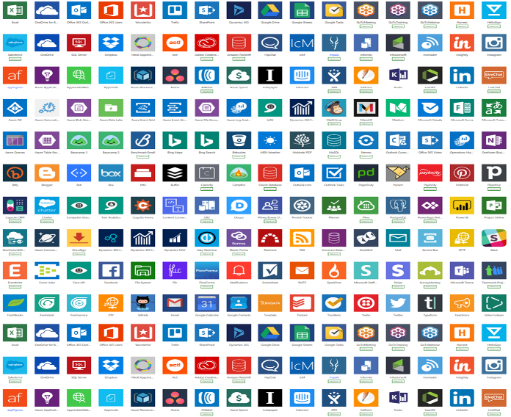
Low code in digital transformation
Some processes are best solved by off-the-shelf SaaS solutions.
But there isn’t always “an app for that.”
Some processes are best be solved by custom app development.
But there is only so much custom app development an organization can invest in.
Everything else is a missed opportunity to optimize and innovate. Low-code development solves this for you.

Slide 11
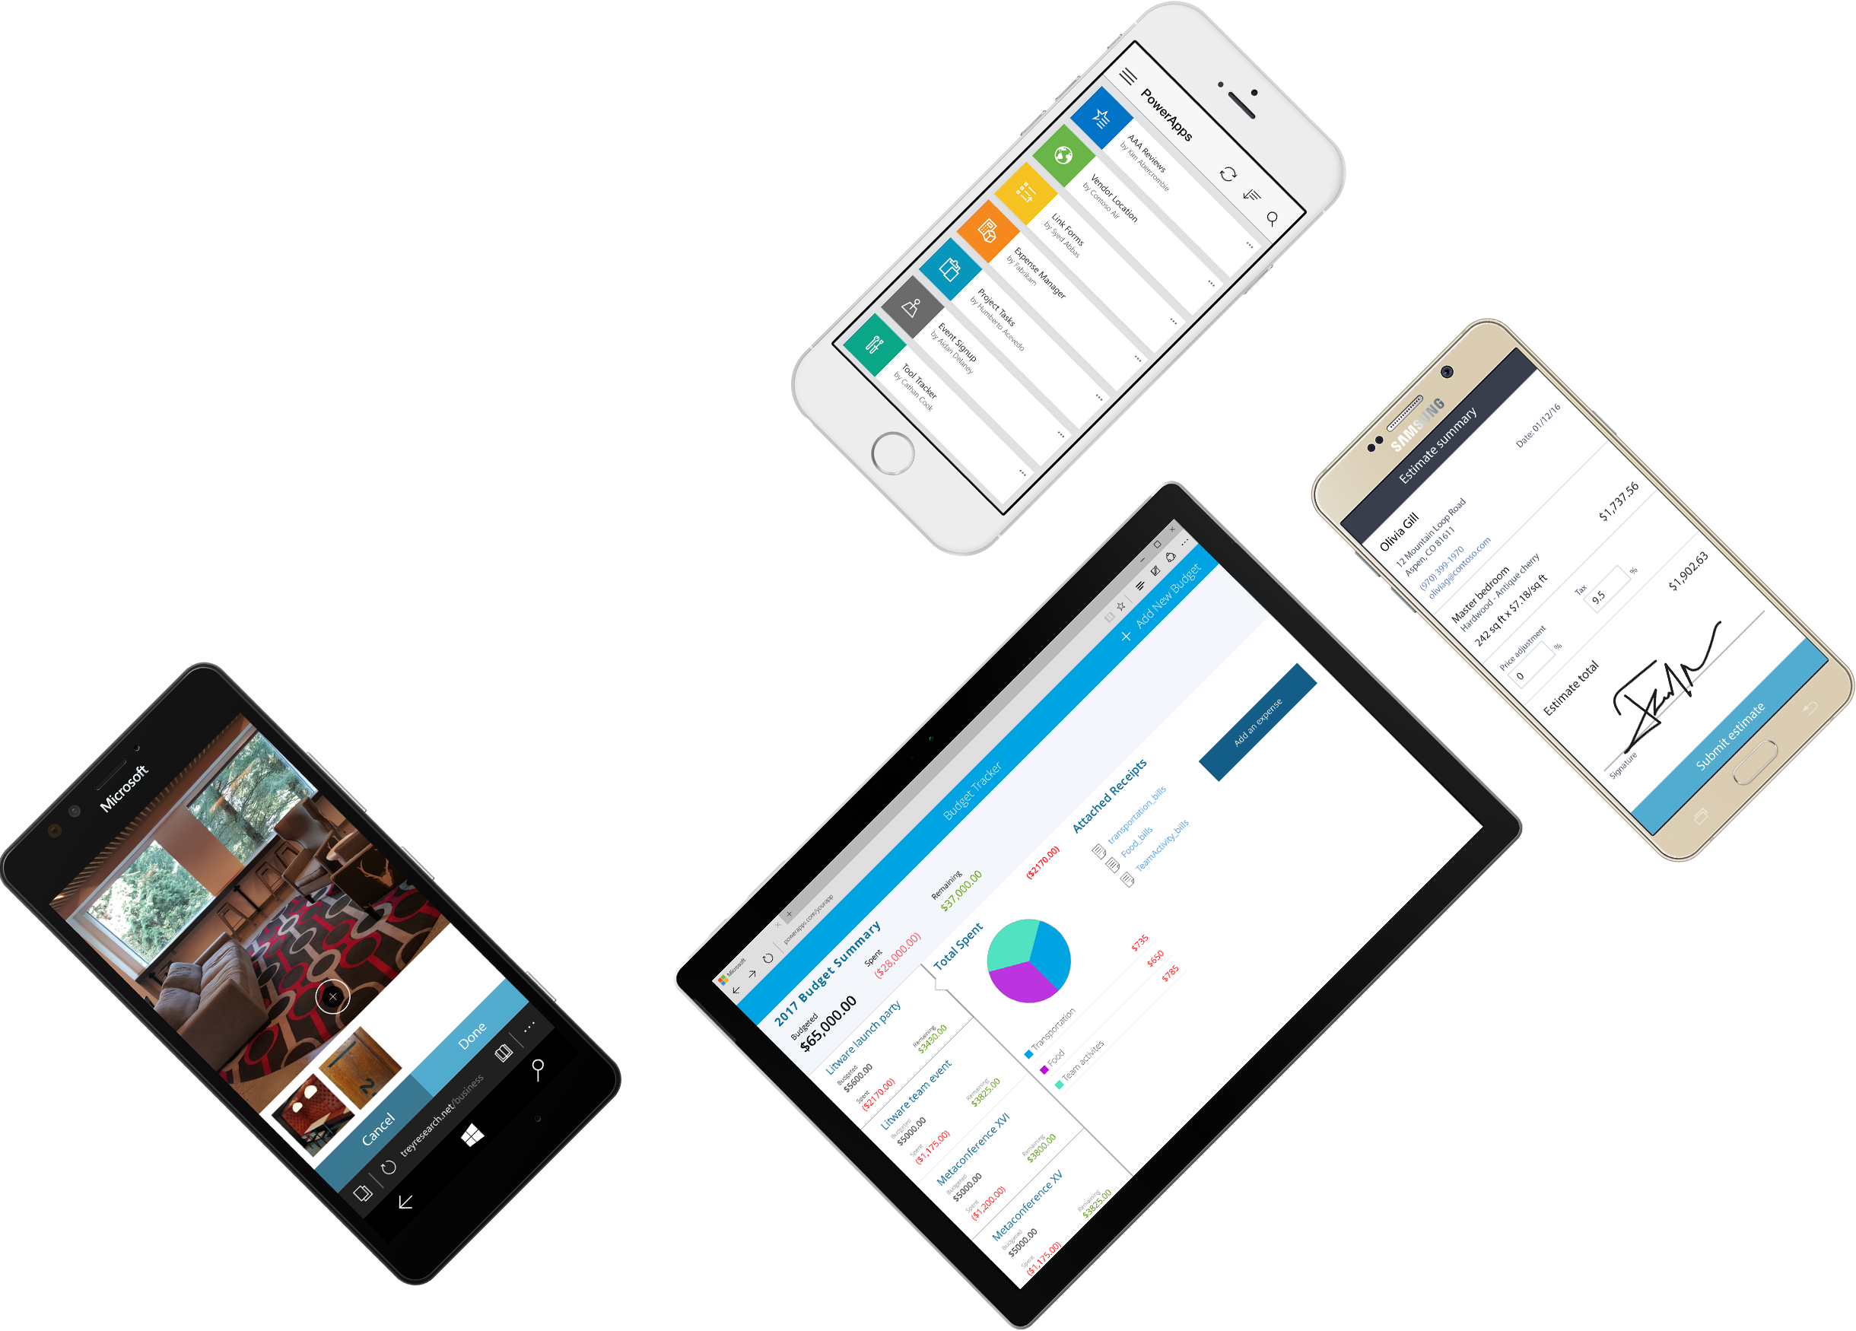
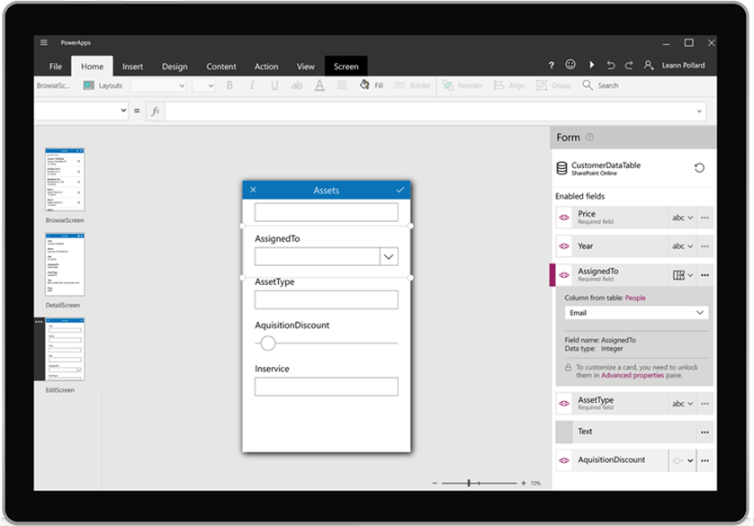
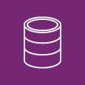
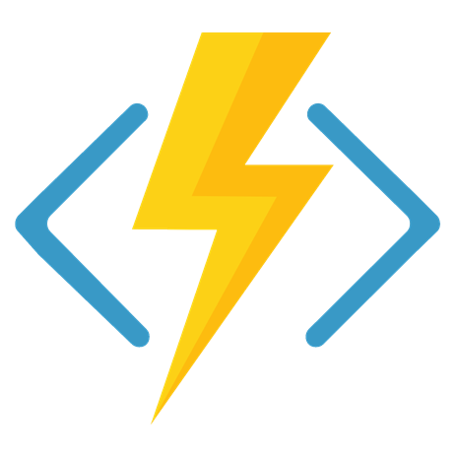




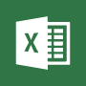







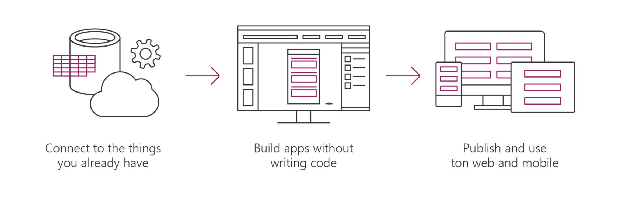


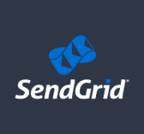

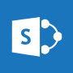






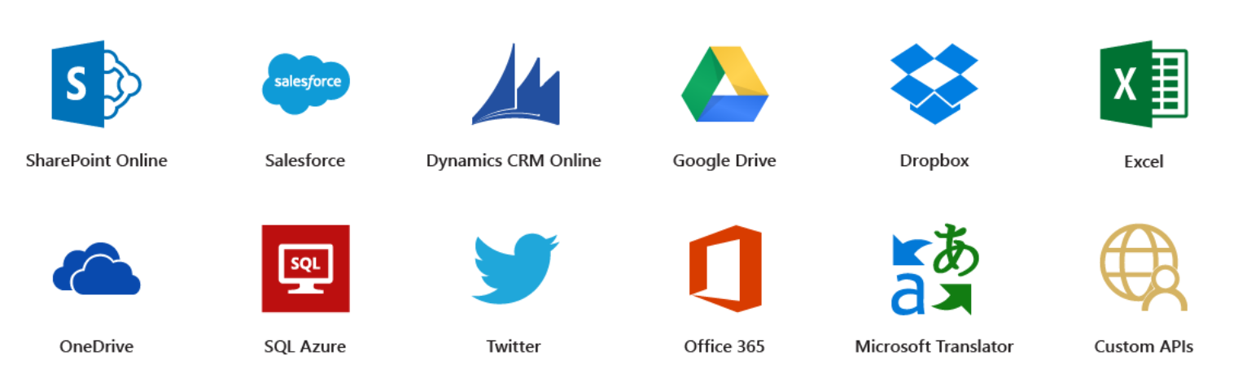
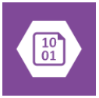



Microsoft PowerApps
Connect to existing systems and data sources
Common Data Platform
Azure Functions & REST services
Build apps, forms, and workflows without writing code
Publish apps instantly for web and mobile
Notes:
Microsoft PowerApps is a service for creating and using custom business apps across platforms

Slide 12
Benefits of PowerApps
Secure Scalable Managed Integrated Compliant
Fast Iterative
Cross-platform
Beautiful Easy

Slide 13
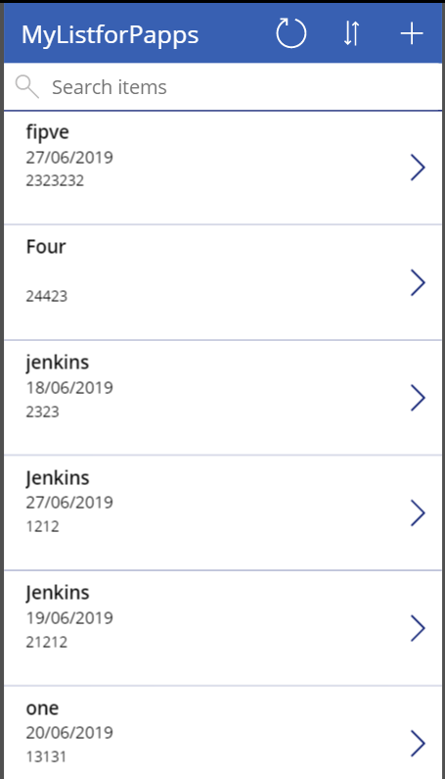
What can I build with PowerApps?
Apps based on data (SharePoint*, SQL, but also DropBox and Google Drive)
Onedimensional, form-based apps
Simple, single-task apps
Microphone, camera, GPS coordinates. Ink and pen support.
Multiple data sources in one app
Multiple screens

Slide 14
86% of the Fortune 500 are using Power Apps

Slide 15
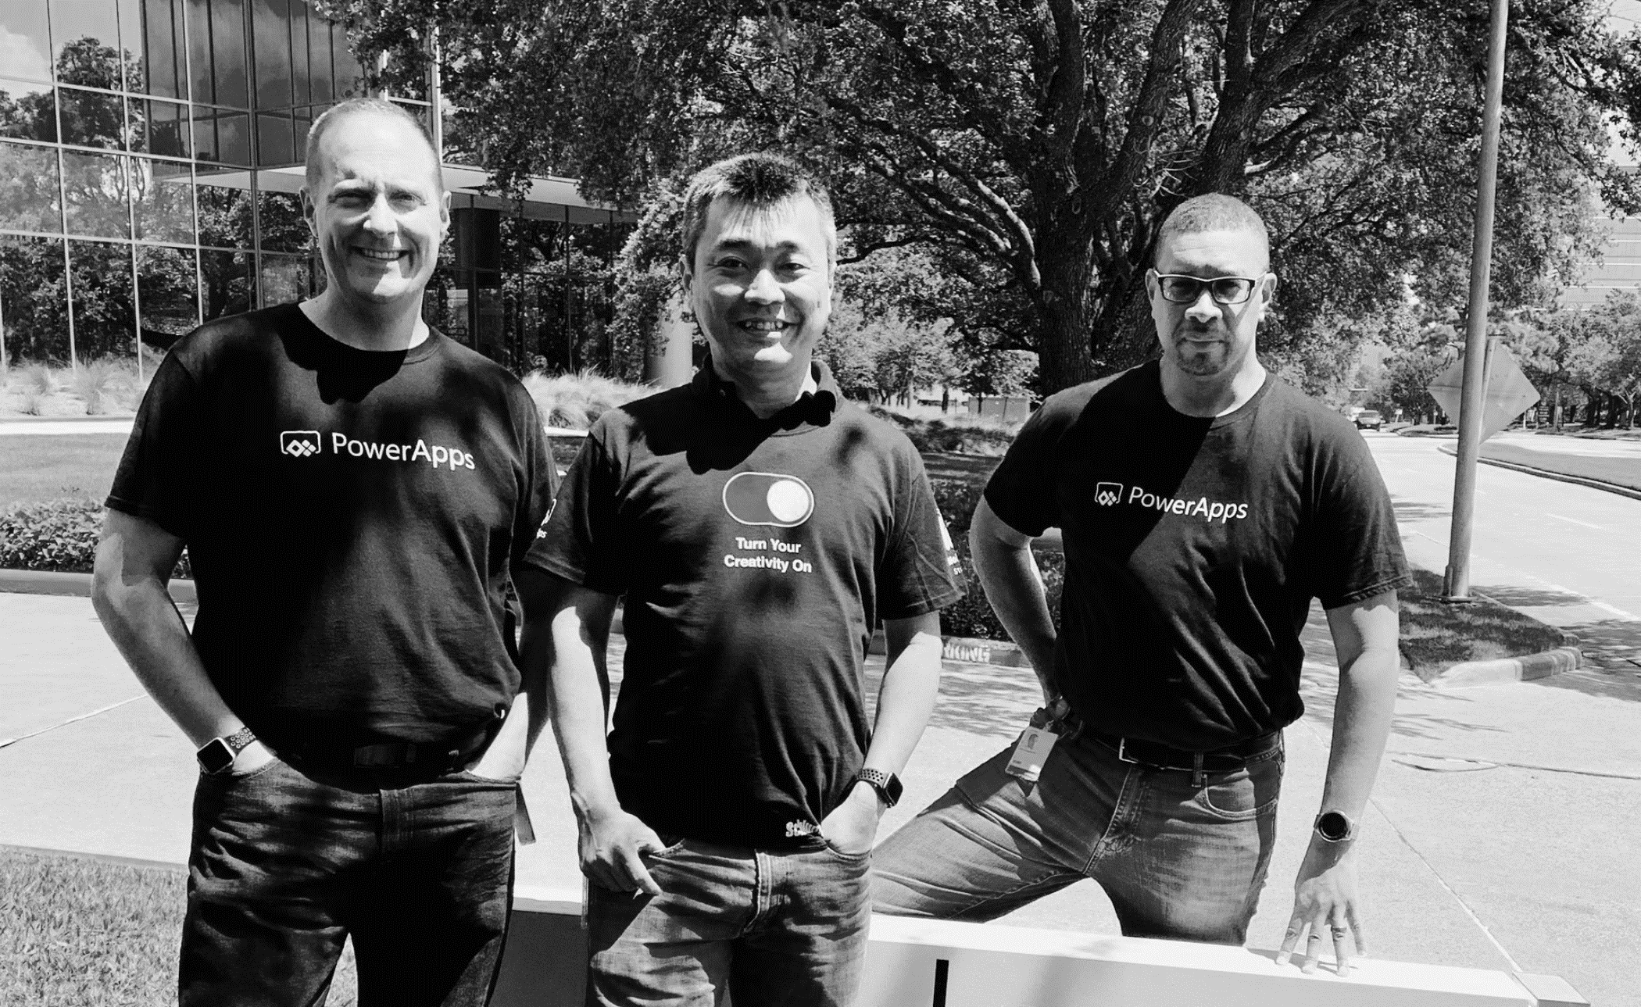
Pro dev
Citizen dev
IT admin
Empower every developer to do more.

Slide 16
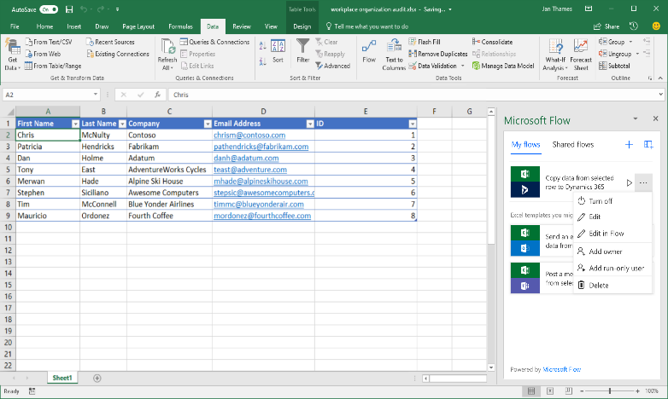
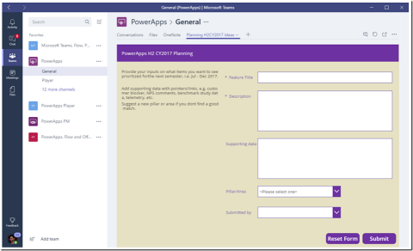
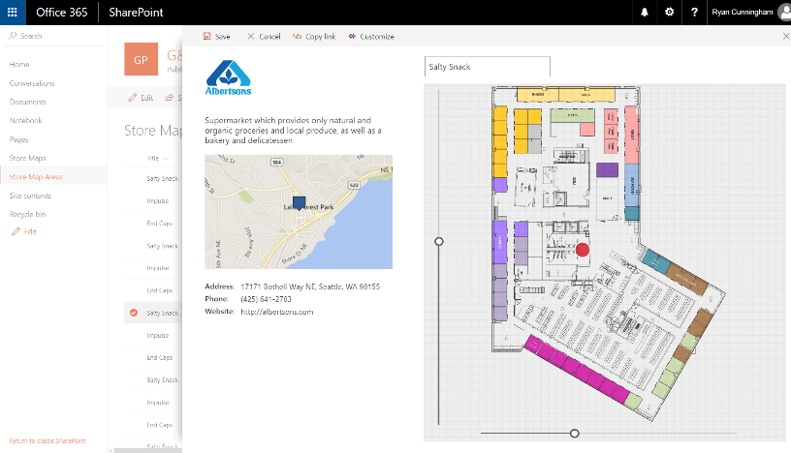
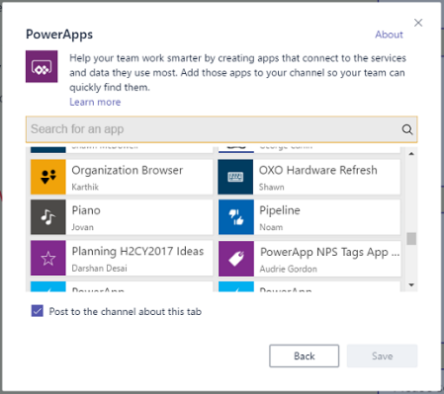
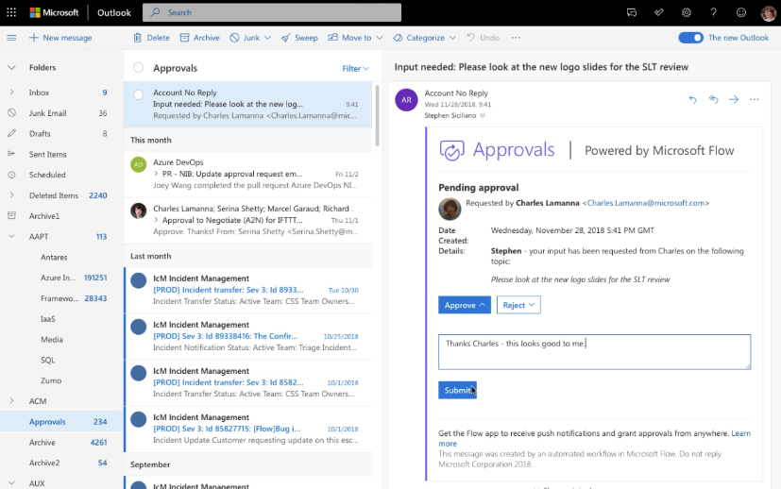
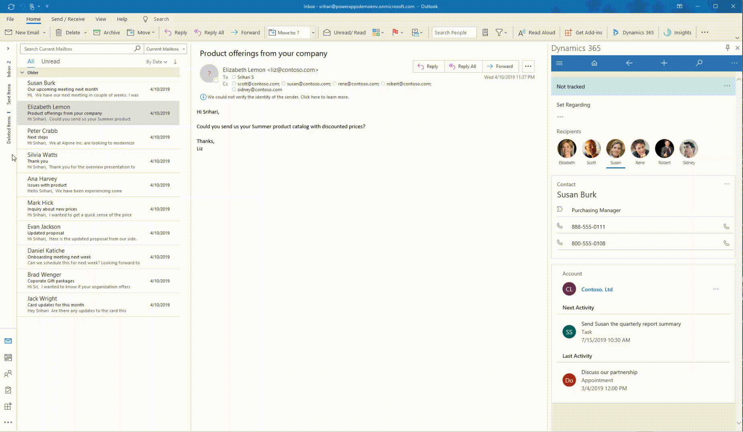
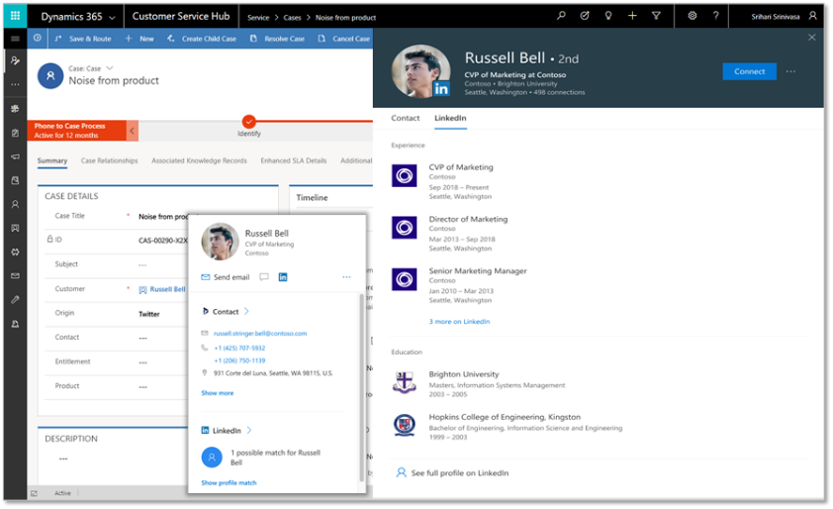
Deeply integrated with Microsoft 365
Customize the experience and automate SharePoint Lists with PowerApps and Flow
Build a PowerApp app from an Excel sheet or automate on an Excel sheet with Flow
Customize a tab with PowerApps, or automate a bot or process with Flow
Enhanced communication with Actionable Messages and Adaptive cards in Flow
Bring data from CDS and PowerApps UX to Outlook with the Mail App (WIn32, OWA and mobile)
Office 365 People Card in PowerApps + Dynamics (incl. LinkedIn info)

Slide 17

Why did we go with PowerApps
We needed a digital onboarding experience with a clear path for customers to follow in self-service planning of their Dynamics 365
Traditional web portals and custom apps are of course great if you know exactly what that path should look like
What we needed the most was the ability to experiment with the elements that should/shouldn’t be included in the onboarding path
Low-code/no-code approach of PowerApps canvas apps significantly lowers our need to commit to any specific feature or idea
Ability to delay developing any tailored UI or integration running on custom code, to the point when you know what you want to automate

Slide 18

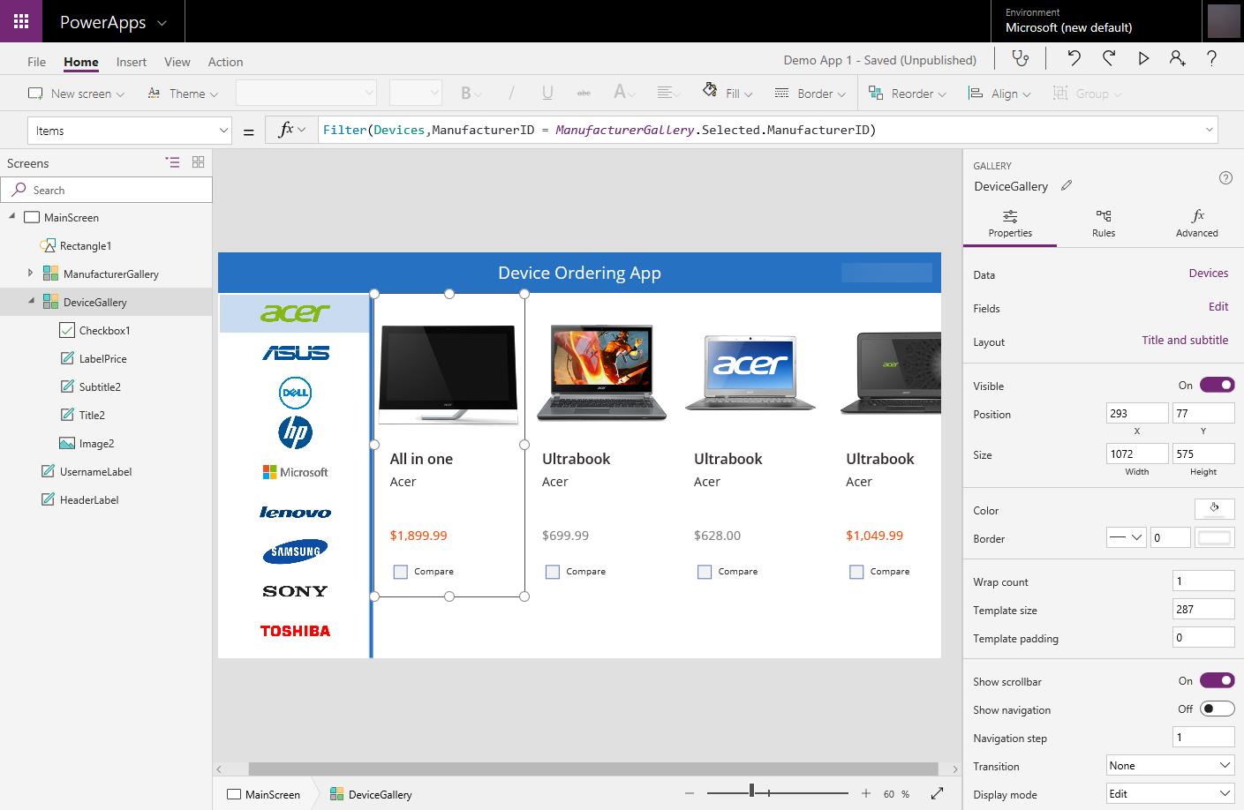

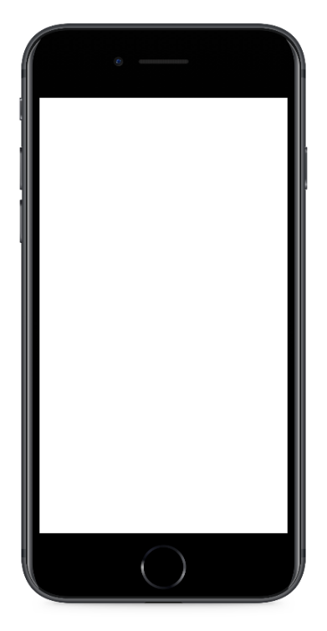
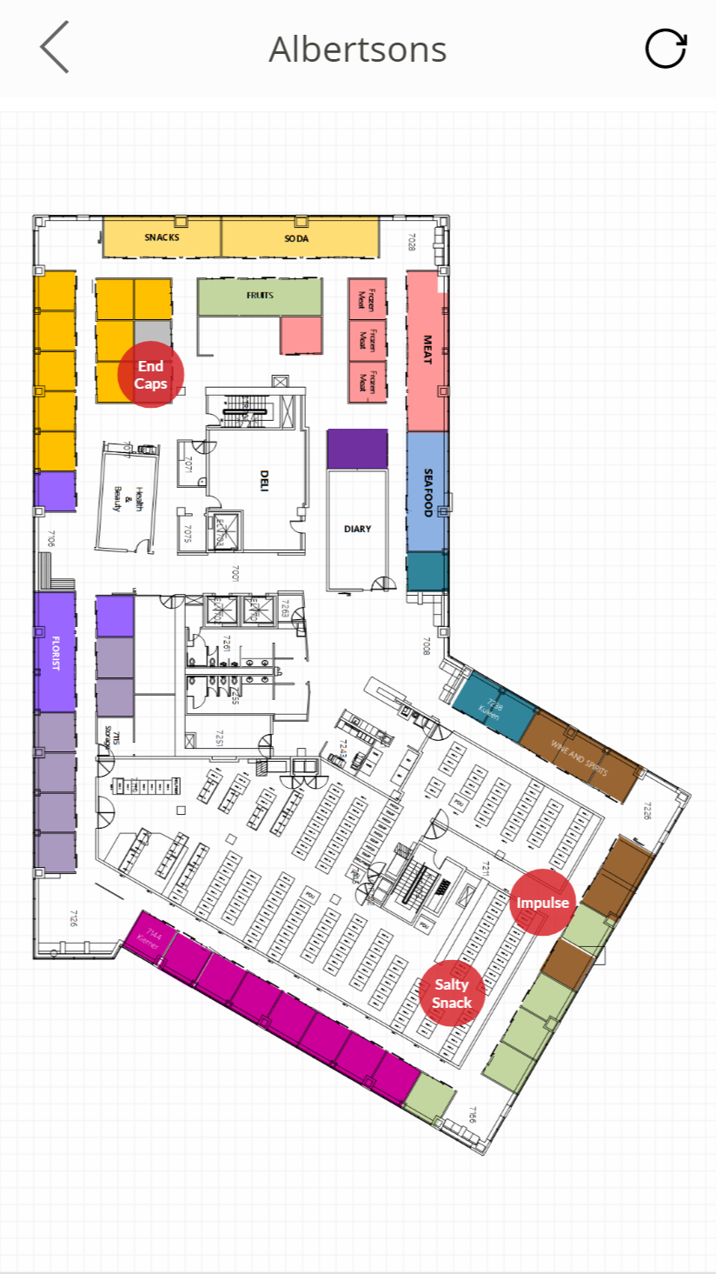
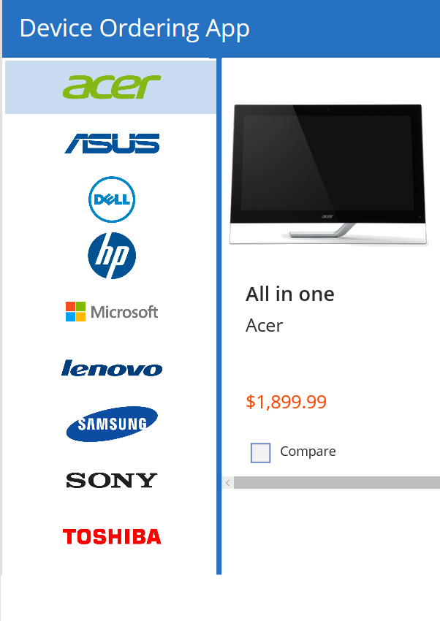
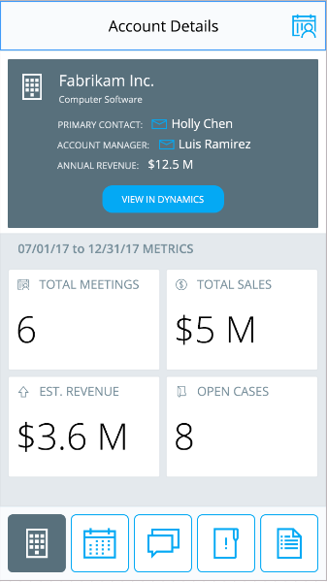

Power Apps: a low-code approach to building apps
Easily build apps with a full featured low-code / no-code platform
Connect to your existing data with 250+ pre-built connectors and custom connectors
Store your data in the Common Data Service
Integrated with Office 365, Azure, Dynamics 365, and Power BI
Strong enterprise governance & security
Pro-dev extensibility

Slide 19

Power Platform
Power Automate
PowerApps
Power BI
Also known as “Business Applications Platform” or “BAP”
Create business processes
Build apps easily & speedily
Gain global insights instantly

Slide 20
Power Platform
Common Data Services
Enables data from multiple data sources works together
Power Automate
PowerApps
Power BI
Connectors, Gateways, APIs
250+ built-in and custom connectors
Seamless connectivity to On-Prem systems or cloud services
Foundational Services
Pro Developer Extensibility
Empowers the pro developer with more sophisticated developer capabilities
Connectors and Gateways
Common Data Service
Pro dev extensibility

Slide 21
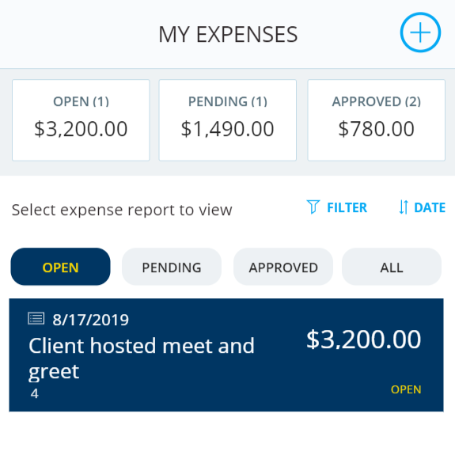
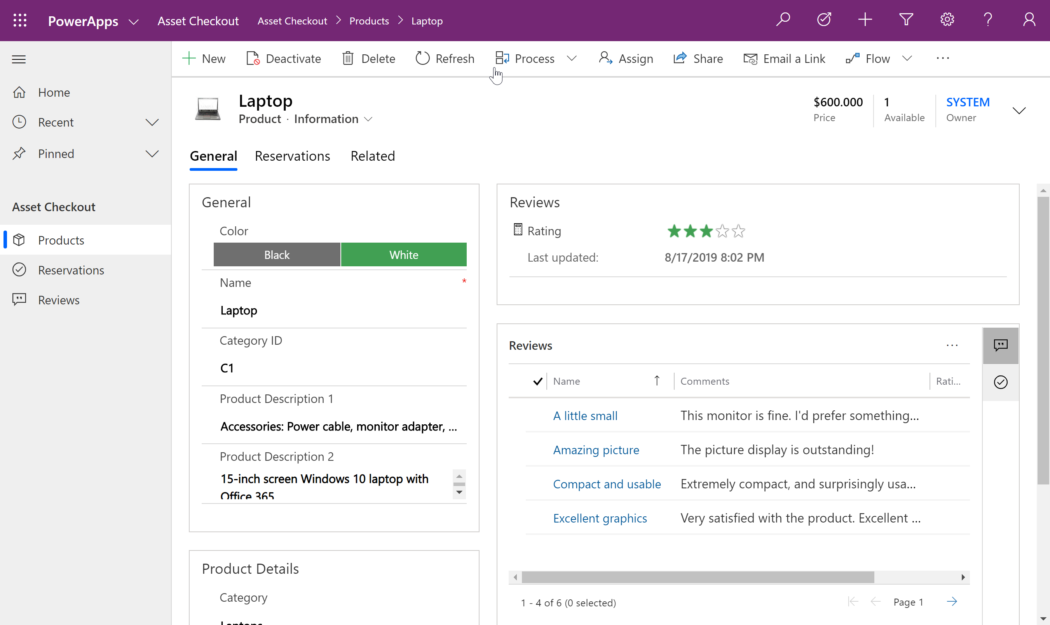
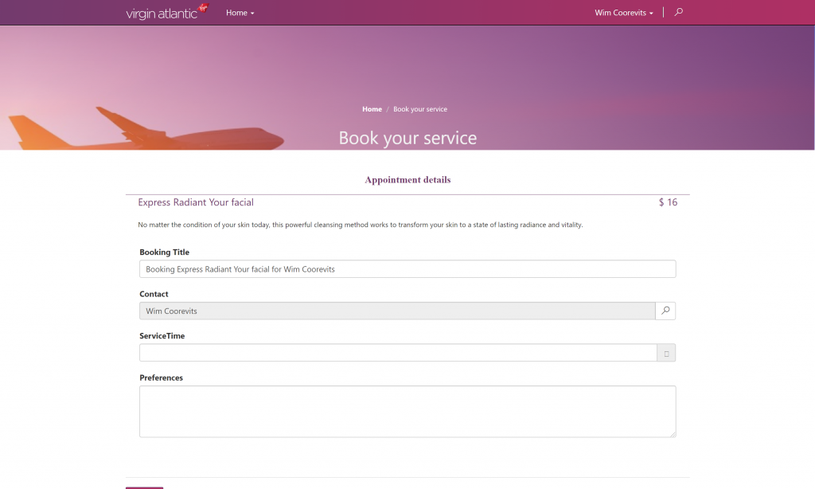
Types of Power Apps
Canvas Apps
Model Driven Apps
Portals

Slide 22


Power Platform
Create reusable components & services
Build enterprise applications
PowerApps
Model-Driven Apps
Build model-driven & canvas apps
Extend model-driven components or apps by creating different UX
Create easy task-based apps
Canvas Apps

Slide 23

Canvas Apps

Slide 24
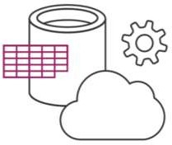
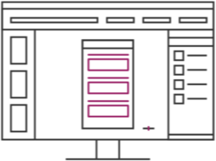
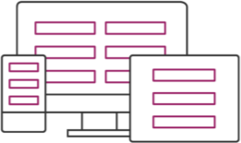
Canvas Apps help business-power-users to create and use custom business apps across platforms using Excel and PowerPoint skills
Connect to data & systems you’re already using easily
Create apps, forms, and workflows without writing code
Use apps on any device – both web and mobile

Slide 25
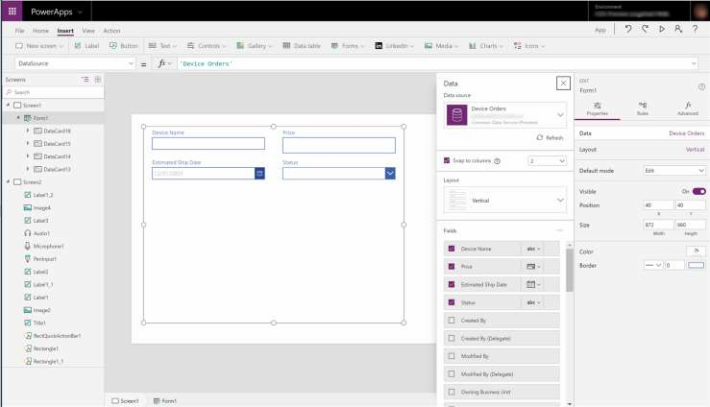
EASY AUTHORING
Truly WYSIWYG – full control over user experience, use it as you build it
Create app logic with familiar Excel-like expressions
Mash up data from multiple
sources right at the app level

Slide 26
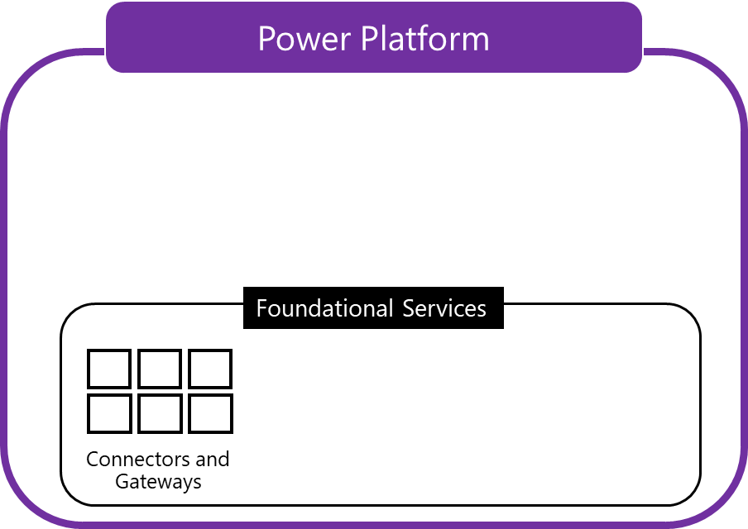
Built-in connectivity to 200+ cloud services, files, databases, web APIs, etc.
Seamless hybrid connectivity to on- premises systems via the On- Premises Data Gateway
Build custom connectors for everyone to leverage

Slide 27
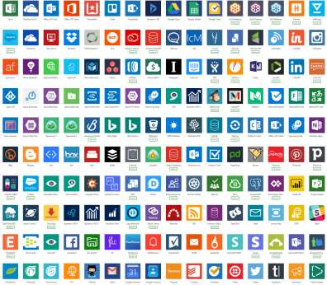
CLOUD AND ON-PREMISES CONNECTIVITY
Built-in connectivity to 200+ cloud services, files, databases, web APIs, etc.
Seamless hybrid connectivity to on- premises systems via the On- Premises Data Gateway
Build custom connectors for everyone to leverage

Slide 28
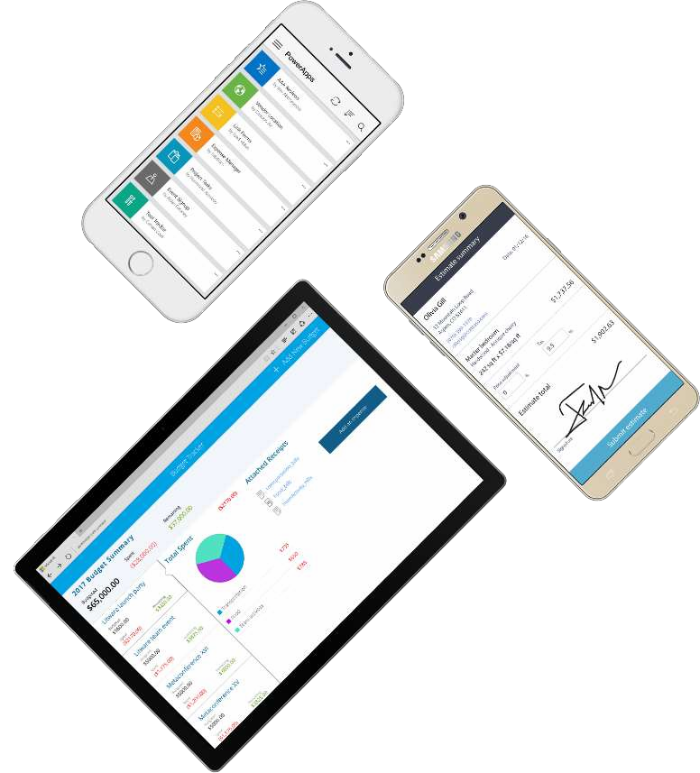
CROSS-PLATFORM
Publish instantly to iOS, Android,
Windows, and the web
Sharing apps is like sharing documents
Manage across environments

Slide 29

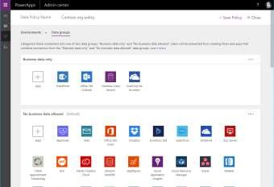
ENTERPRISE-GRADE MANAGEMENT AND CONTROL
All identity is managed through Azure Active Directory, enabling rich policies and multi- factor authentication
Admin Center providing full audit logs, usage analytics, data loss prevention, security and data management
Centrally manage all your apps, first and third party, deployed across your organization

Slide 30
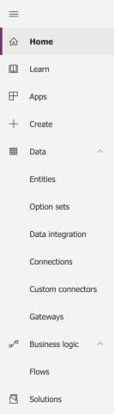
POWERAPPS MAKER PORTAL [HTTPS://WEB.POWERAPPS.COM/]
Home page for Makers
Learn
Guided learning, documentation, community, what’s new
Apps
View apps, open apps, create new apps, run sample apps, create apps from sample apps
Create
Create new apps from blank or from sample apps
Data
Manage Entities, option sets, data integration, connections, custom connections & gateways
Business Logic
Add Flows to your apps
Solutions
Create packages of PowerApps, Flows and CDS Entities (Solutions), distribute them to your customers or move them across environments

Slide 31
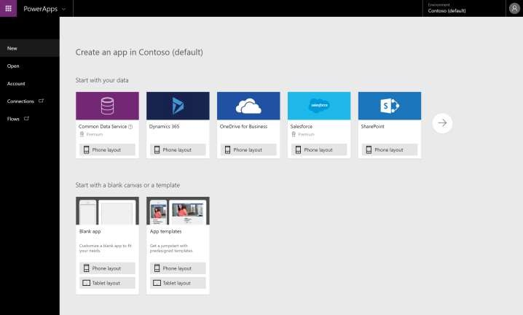
POWERAPPS STUDIO FOR THE WEB [HTTPS://CREATE.POWERAPPS.COM/]
Canvas apps authoring experience
Start with your data
Start with a blank canvas
Start with a template

Slide 32
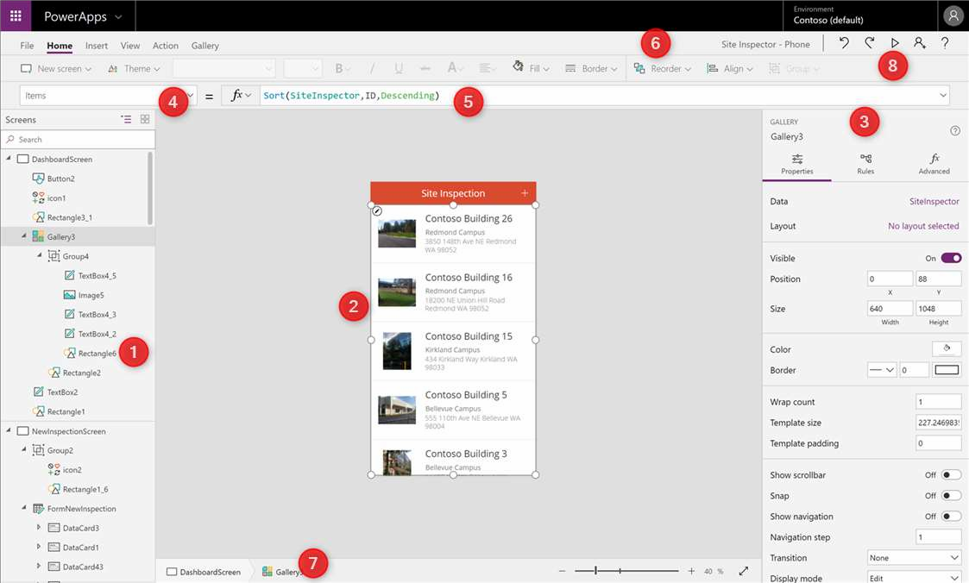
POWERAPPS STUDIO PARTS
Left Navigation bar
Middle pane (current screen)
Right hand pane
Property Pane
Formula bar
Ribbon
Bread crumb navigation
Preview button (F5)

Slide 33

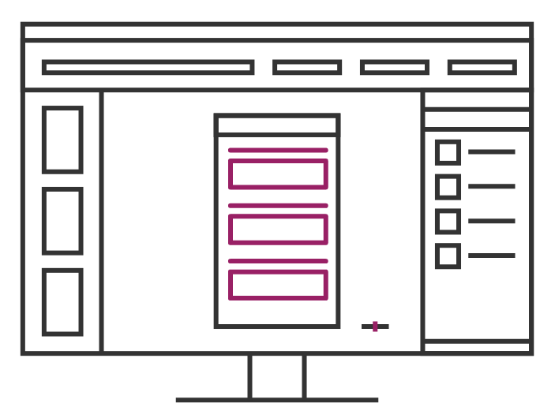
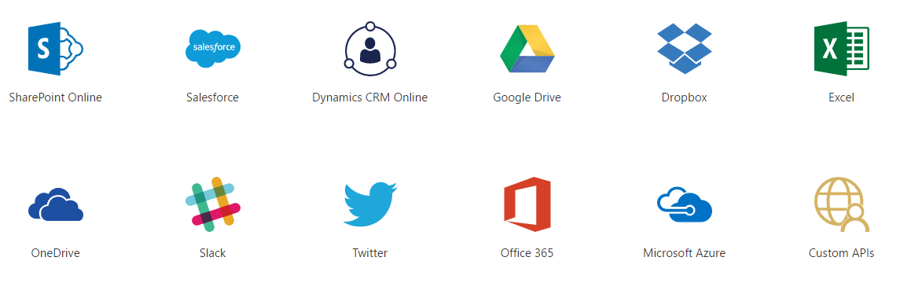
Data Sources and connections

Slide 34
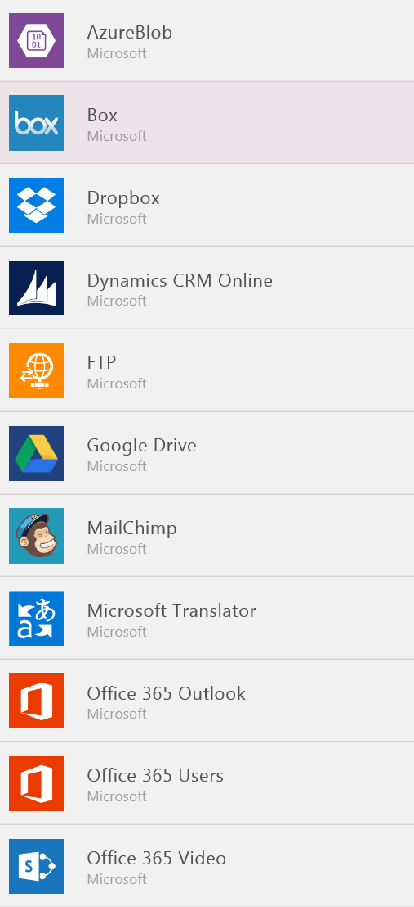
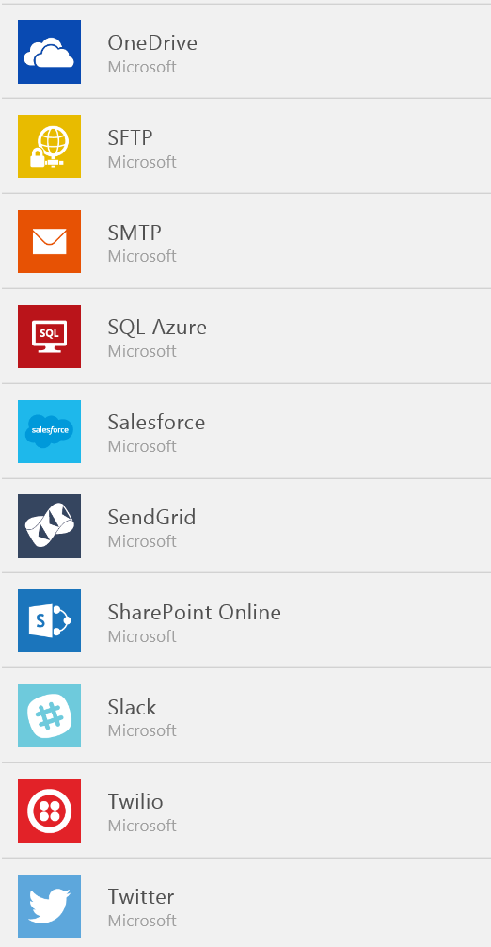
Data Sources…
SaaS Data Sources
Excel on OneDrive
Excel on Dropbox
Excel on Google Drive
Office 365
SharePoint Online Lists
Google Sheets
Sales force
Dynamics CRM

Slide 35
Demo
Create the records in Dynamics CRM with the blank canvas app using Patch function

Slide 36
Thank you

